Slide 1


ROLL-97/CSM/130026
M. TECH 4th SEMESTER
COMPUTER SCIENCE & ENGINEERING
UNIVERSITY OF CALCUTTA
Of 27

Slide 2
EUVL TECHNOLOGY (EXTREME ULTRAVIOLET LITHOGRAPHY)
Extreme ultraviolet (EUV) lithography is the industry’s only viable single pass patterning technology for critical layers of 10 nm chip designs and beyond.
Uses Laser Produced Plasma (LPP) for EUV sources [6] generate 13.5 nm (wave length) light
light radiation is strongly absorbed at this wavelength, the entire EUVL scanner system must be in a vacuum environment, and all optics must be reflective, not refractive
printing circuits at the 32-nm model
Of 27

Slide 3
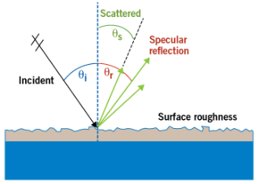
DEFINITION OF FLARE IN EUVL
Flare is the defect on chip by radiation of UV light
F = D_{v} PSF [2] (Point spread function)
Flare in EUV systems is caused by surface roughness in the mirrors. Incident light is scattered in multiple directions in addition to the specular direction
Scattering is inversely proportional to the wavelength squared, thus it is more prominent for 13.5nm EUV
Of 27

Slide 4
PHYSICAL DESIGN CYCLE
We are working on the Routing phase of the physical design cycle.
The process of finding the geometric layouts of all the nets
Applied after the exact locations of blocks and pins are determined through placement phase
  Global Routing
  Partitions routing regions into tiles and generates a ‘loose’ route for each net
  Assigns a list of routing regions to each net without specifying the actual geometric layout of wires
Of 27

Slide 5
MOTIVATION
Traditionally used methods for flare reduction involves Dummification [2] where amount of vacant region is decreased by putting an effective number of non-functional blocks (Dummy) which in turn reduces the flare.
Dummy filling implies adding extra features into the mask as a result mask preparation cost can be increased in a large amount.
Our objective is to reduce flare without using Dummy fill.
Of 27

Slide 6
PATTERN DENSITY AND VACANCY DENSITY
Pattern density defined as the ratio of actual area of patterns currently present in the cell or grid and total pattern area that can be allotted
Vacancy density map is computed as the (1-pattern density)
COMPUTATION OF FLARE
F(m, n) = D_{v}(m, n) PSF(m, n)
Where F(m,n), D_{v}(m,n) and PSF(m,n) are the flare, vacancy density and scattering point spread function (PSF) for a cell or grid (m,n).
Of 27

Slide 7
DEFINITION OF THE PROBLEM
  Given a set of nets (nets are a set of points which has to connected).
  A path or a route between two closer points is a subnet.
  We have to connect the maximum no. of subnets with minimum flare.
Of 27

Slide 8
OVERALL FLOW
1. RANDOMLY GENERATE SOME NETS
2. SORTING OF NET POINTS
3. GENERATION OF ALL POSSIBLE PATHS
4. ACCEPTANCE TEST FOR ALL X_{ij}
5. CALCULATION OF THE TOTAL CAPACITY C_{g(m, n)} FOR EACH GRID
6. CALCULATION OF THE DENSITY VALUE D_{g(m, n)}
7. CALCULATION OF THE CAPACITY O_{ij}^{g(m, n)}
Of 27

Slide 9
OVERALL FLOW
1. RANDOMLY GENERATE SOME NETS
All nets are divided into 2 terminal subnets.
Example :
Say [ (5,6), (8,9), (20,6), (4,8) ] is a net.
The sub nets will be [ (5,6), (8,9) ], [(8,9), (20,6) ], [ (20, 6), (4,8) ]
So if there is p no. of points in a net then no. of subnets will be p-1.
Of 27

Slide 10
OVERALL FLOW
2. SORTING OF NET POINTS
according to Hamiltonian distance
while we are routing a couple of points (subnets), we can choose a path of minimum wire length.
Of 27

Slide 11
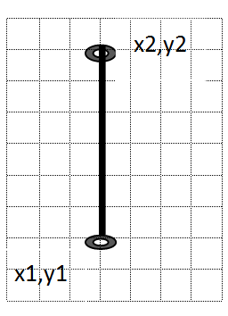
OVERALL FLOW
3. GENERATION OF ALL POSSIBLE PATHS
These paths are generally I, L and Z type in shape.
An ‘I’ shaped path
Of 27

Slide 12
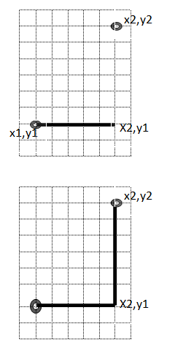
OVERALL FLOW
3. GENERATION OF ALL POSSIBLE PATHS
These paths are generally I, L and Z type in shape.
an ‘L’ shaped path
Of 27

Slide 13
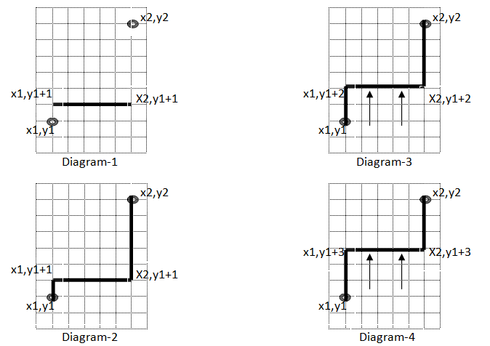
OVERALL FLOW
3. GENERATION OF ALL POSSIBLE PATHS
These paths are generally I, L and Z type in shape.
a ‘Z’ shaped path
Of 27

Slide 14
OVERALL FLOW
4. ACCEPTANCE TEST FOR ALL X_{ij}
After generate a possible path X_{ij} we have to check whether it passes through any terminal of other subnets.
If it passes through any terminal of other subnets then we discard the path.
Of 27

Slide 15
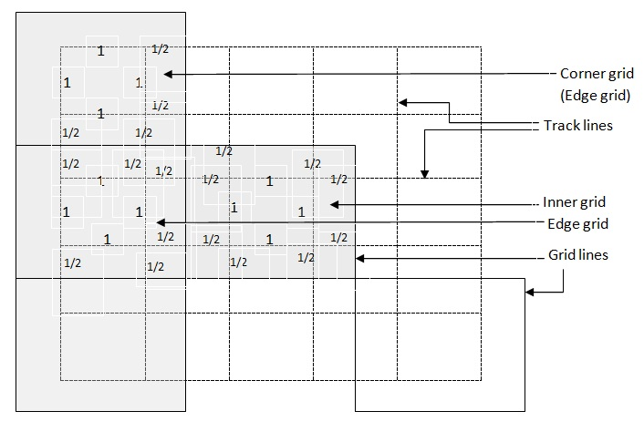
OVERALL FLOW
5. CALCULATION OF THE TOTAL CAPACITY C_{g(m, n)} FOR EACH GRID
If we consider that ‘t_{r}’ is the no. of horizontal as well as vertical track inside a grid then wire length capacity of a inner grid will be C_{g(m,n)} = 2t_{r}²
outer grid will be
C_{g(m,n)} = 2t_{r}²-(t_{r} x 0.5)
corner grid will be
C_{g(m,n)} = 2t_{r}² - 2(t_{r} x 0.5).
Of 27

Slide 16
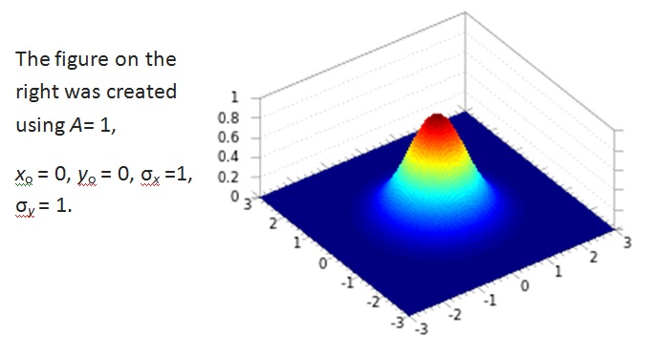

We use a Gaussian density function for calculation of target density value D_{g(m ,n)} for each grid g(m, n).
Here A is the amplitude x₀ , y₀ is the center σ_{x} , σ_{y} are the spreads along x and y respectively. [1]
OVERALL FLOW
6. CALCULATION OF THE DENSITY VALUE D_{g(m, n)}
Of 27

Slide 17
OVERALL FLOW
7. CALCULATION OF THE CAPACITY O_{ij}^{g(m, n)}
O_{ij}^{g(m, n)} is the capacity of X_{ij} in grid g(m, n). That means how much wire length will occupied of grid g(m, n) if path X_{ij} is selected for routing.
1. we take points one by one
2. check whether it is inside the grid g(m, n).
3. count how many points are inside that grid
4. process will end when we found a point outside of that grid
If first point of the path is inside the grid then -
O_{ij}^{g(m, n)} = 0.5 + no. of points in the grid g(m, n) - 1 + 0.5
If first point of the path is not inside the grid then -
O_{ij}^{g(m, n)} = no. of points in the grid g(m, n) - 1 + 0.5
Of 27

Slide 18
ILP FORMULATION
We are proposing a global routing method.
we use Integer Linear Programming (ILP) procedure.
Input for that global routing will be a set of net (N) and the total layout area (X x Y). X and Y is the number of tracks along X axis and Y axis respectively. Output of our method will be a global routing which will satisfy the density constraints.
We divide the total layout area into some grids. Let m is the no. of grids along X axis and n is the no. of grids along Y axis.
We calculate target density T_{g(m, n)} = C_{g(m,n)} x D_{g(m, n)} where C_{g(m,n)} is the total capacity and D_{g(m, n)} is the density calculated by the gaussian density function for each grid g(m, n).
Of 27

Slide 19
ILP FORMULATION
We divide each net into 2 terminal subnets. Now we take all possible path between 2 terminals of every subnet.
We assign a binary variable X_{ij} for each possible path where i denotes the possible path number and j denotes the net number for X_{ij}
If X_{ij} is selected by ILP then the capacity occupied by X_{ij} in grid g(m, n) is capacity O_{ij}^{g(m, n)}.
If we consider k is the no. of possible path for a particular subnet.
Of 27

Slide 20
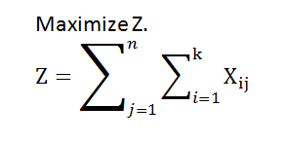
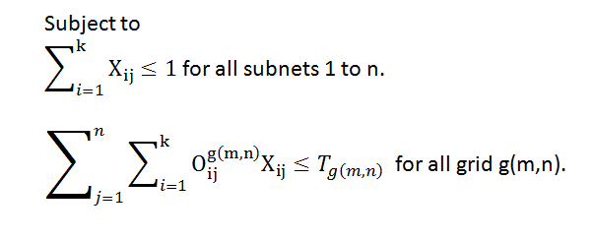
ILP FORMULATION
X_{ij} = { 0 , 1 }
Of 27

Slide 21
For our experiment we solve the ILP formulation by ‘lp_solve’ [3] and our source code is written in C language.
We use ‘scilab’ [4] [5] for the calculation of flare. For calculation of convolution standard deviation.
Here we take some nets randomly in 20 x 20 as a layout area.
Each net have 2 to 8 points. Here any two points (x1,y1) and (x2,y2) connected by a path is called subnet.
Here we give 50 examples and comparing with uniform global routing and global routing guided by Gaussian density function.
we are using a PC (desktop), having dual core processor ( 1.6 GH_{z}) 2GB RAM for the computation.
Of 27

Slide 22
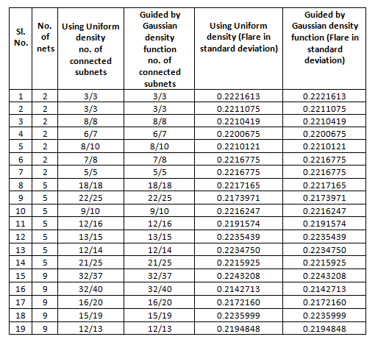
column 3 and 4 represents no. of subnets are connected.
6/7 means 6 subnets are connected out of 7 subnets
Of 27

Slide 23
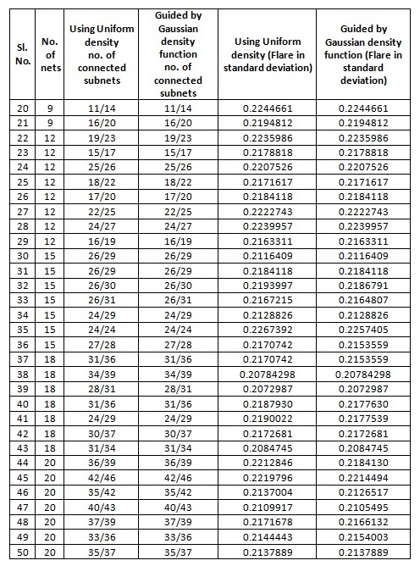
column 3 and 4 represents no. of subnets are connected.
6/7 means 6 subnets are connected out of 7 subnets
Of 27

Slide 24
As it is a global routing (which will minimize the flare) so after routing we need not insert dummy fill that is why it is efficient than dummification. Again it is useful than perturbation technique of flare minimization as we need not route more than one times.
Here we give 50 examples and comparing with uniform global routing and global routing guided by Gaussian density function. As we are using a PC the computational time required is more so we take upto 20 nets in 20 x 20 layout area. For a faster machine it is possible to take large value as nets and greater layout area.
Of 27

Slide 25
Here we create some nets randomly to route by our algorithm. Now we have to take some standard circuit layout nets from the real world.
Of 27

Slide 26
[1] http://en.wikipedia.org/wiki/Gaussian_function
[2] Shao-Yun Fang and Yao-Wen Chang “Simultaneous Flare Level and Flare Variation Minimization with Dummification in EUVL”, Proc. of the 49th Annual Design Automation Conference (DAC), pp. 1179-1184, 2012
[3] http://lpsolve.sourceforge.net/5.5/
[4] www.scilab.org/content/download/247/1702/file/introscilab.pdf
[5] https://www.scilab.org/content/download/849/.../Scilab_beginners.pdf
[6] www.ijarcsse.com/docs/papers/Volume_4/2.../V4I2-0187.pdf
Of 27

Slide 27
THANK YOU
Of 27

